Slide 2
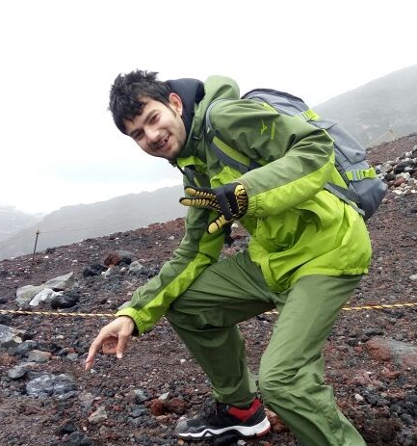
Mt. Fuji
Name : Shayan Khan
Team : Advanced DevOps
Origin : New Delhi, India
College : College of Engineering, Pune Major : Computer Engineering
Hobbies : Bike riding, Travelling, Trekking, Basketball, Hackathons, Music
Notes:
40

Slide 3
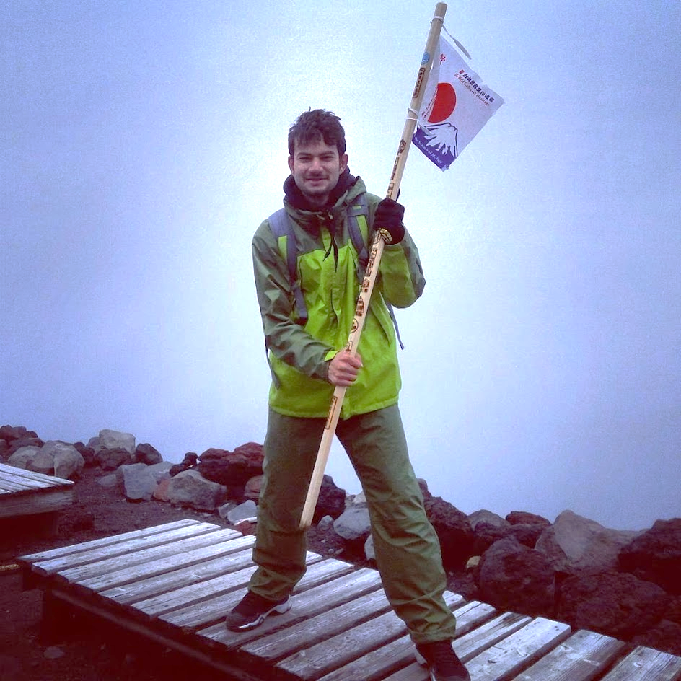
Experience & Technical Skills
Present Positions
Past Experiences
Chief Technology Officer (CTO) Skyline Labs
Campus Ambassador Avaya, India
Head of Operations & Project Management Software Development Section COEP
Event Head
Entrepreneurship Festival COEP
Data Mining, Big Data Analytics, Deep Learning
IoT & Cloud
Blockchain, Smart Contract
Websites, Android Apps, Android Games
Notes:
100
As far as my technical skills and experience is concerned, I am the Chief Technology Officer (CTO) of a start-up Skyline Labs, Head of Operations & Project Management of SDS, The Software Development Section of our college COEP. Before this, I was the Event Head of Entrepreneurship Festival in COEP footfall 5k & Campus Ambassador of a networking company Avaya.
I am a tech enthusiast and passionate about programming. I have participated in more than 15 Hackathons across the country in 3 years of my engineering.
About my technical skills :
I have experience in Data Mining, Big Data Analytics & Deep Learning. Some of my recent works include construction of an ANN for the prediction of Trends in Crypto currencies (Bitcoin). I have also done a few projects on IoT and cloud.
The technology that I have been working on recently is Block chain. I am implementing Smart Contracts and integrating Machine Learning in Block chain.
Apart from all this, I have also made a lot of websites, Android apps and a few Android Games
That’s all about me !!
I will briefly give you an an overview of what this ppt is all about.
Advanced DevOps Team Mission:
To accelerate the expansion of DevOps in NTT Data.

Slide 4
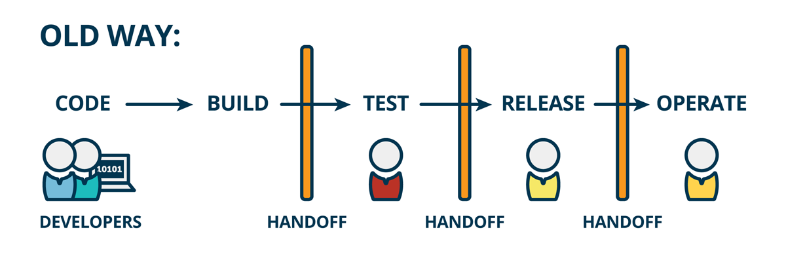
Traditional Software Development Process
Each Step is done manually
Notes:
20
Where several developers used to code, Occasionally or after a specific period, all the progress was integrated.
Then it was built, tested and released for the operations team. But each of these steps were done manually.

Slide 5
Drawbacks Of The Traditional Software Development Process
Infrequent code integration → Infrequent builds → tough debugging → More time
Less number of releases → Tested only a few times → Poor Quality
Repetitive Manual work of Integrating, Building and Testing the code
Notes:
30 The problem with this methodology is :
Because there is a large gap b/w integration, even separate codes working perfectly fine may encounter some bugs & may not work when integrated together.
As the gap b/w development and integration increases, it becomes more difficult to debug the integration bugs and a lot of time is wasted to fix a code which was perfectly working !
Because the code is not built frequently, it is not released frequrnlty for testing. Because of this lack of testing, quality is compromised.

Slide 6
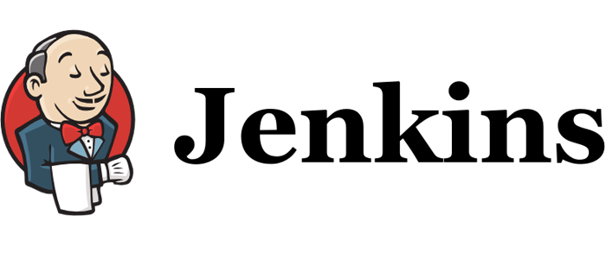
Continuous Integration & Continuous Deployment
Notes:
Integrate as you develop

Slide 7
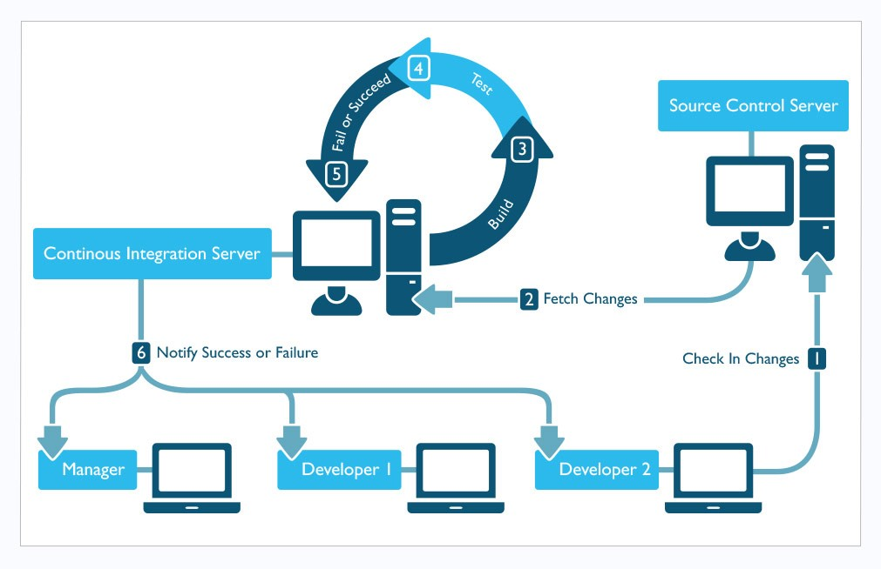

Notes:
20
If you look at this system, this is the CI server which takes care of all the manual work and automates it. IT keeps a check on the SCM. As soon as there is any changes / commit, it automatically pulls the source code, builds it, tests it and sends the report to the developers.
Here, Developers don’t need to wait for integration. They only need to push their codes. Rest everything is automated and CONTINOUS. There is no gap b/w development and integration.
As soon as there is a push, integration is triggered and building and testing is started. In case there are any bugs, they can be detected and fixed immediately.
The time wasted on fixing the integration bugs is saved. Continuously integrates code as it is developed.
This automated environment is called CI/CD

Slide 8
Problems In Introducing CI/CD
Lack of portability
Inconsistencies in the development & production environment
Unnecessary increase in Man-hours
Lack of rigorous testing
Difficult to maintain good Quality
Increased Delivery time
Re-installing the same Jenkins configured environment for different projects.
Unnecessary cost of constructing the infrastructure
Notes:
40
What is the problem ?
What I mean by environment is : Consider an example of a Java code. To build it you need a build tool like maven, for testing you need another tool like selenium. Then there is DB, Deploy server and a lot of other dependencies.
Also, not every version of a tool is compatible with every other version of the other tool. You need to take care of version compatibility while installing all these tools. The enviroenmtn here is all these tools needed to build and test the project.
The environment that each developer uses while developing the code, might be different than the environment used while building the integrated code. Because the code was developed with some specific dependencies and versions, difference in the enviroenmnt may lead to unexpected behavior of the code -> inconsistency. So, the env needs to setup at the production side same as the development side. Since CI/CD is not portable, one has to set it up again at the production side manually and IT become very tedious and time consuming to install so many tools that too with version compatibility. Also, if you plan to expand this CI/CD environment in the company, because of lack of portability, you will have to prepare the same environment individually on each project. Which practically is wastage of time and efforts.

Slide 9
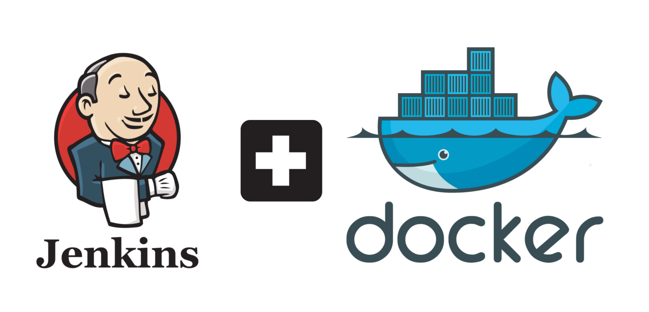
My mission
Help projects to introduce a more portable CI/CD environment
Develop a set of DevOps tools with container technology.
CI/CD with Docker
Notes:
20
This is exactly my mission.
Read which is in my case docker

Slide 10
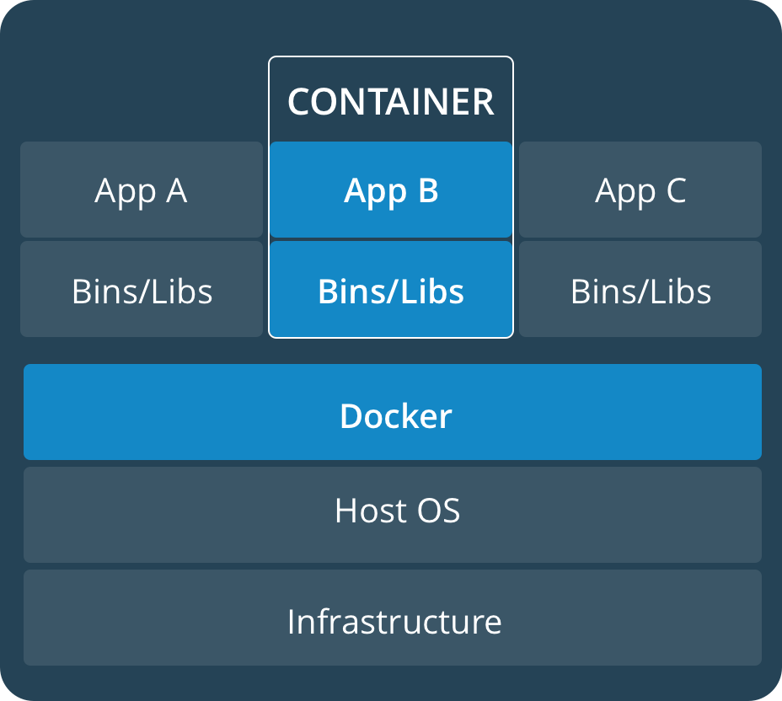
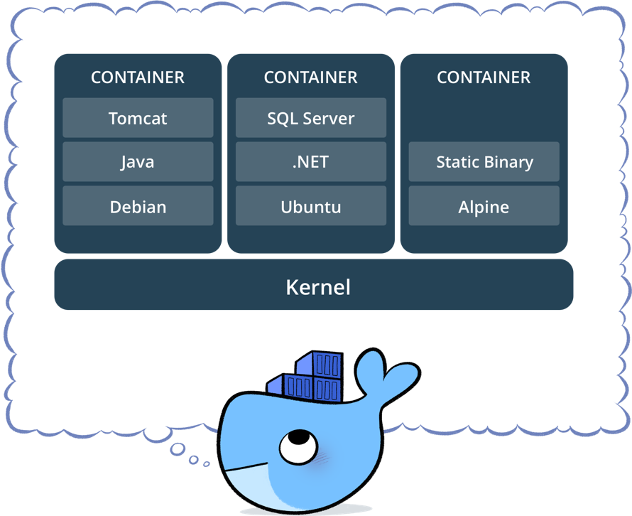
Docker
Configuration, Settings, Environment, System can be packaged as Docker Images
Docker Images are portable
Docker Images can be launched into a container
Notes:
30 In the docker world, everything exists as an image on a central repo called Docker Hub. Anyone can pull the image and use it. The biggest advantage is that since the image is packed with all the needed tools and dependencies with the best compatible versions, the environment is same everywhere.
These images can be customized and run deployed in docker containers.
This entire setup is on just a single kernel

Slide 11
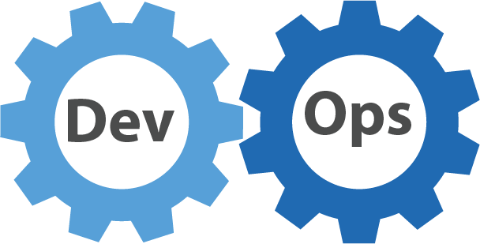
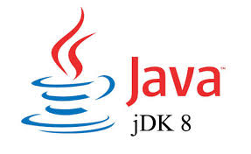
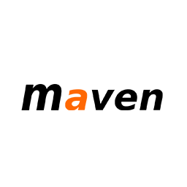
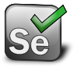
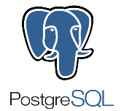
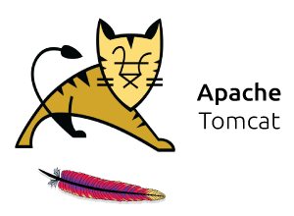



System components & terasoluna framework
Category | Tools
Project | Terasoluna
Source Code Language | Java
Build Tool | Maven
Integration Testing | Selenium
Database | PostgreSQL
Deployment Server | Apache Tomcat
CI Server | Jenkins
Container Technology | Docker
Source Code Management | Gitlab
Notes:
15
Tera is a java project, maven is the build tool, postgresql is db … I have designed this system for sample Terasoluna app using …tech stack…. I learnt these many things in the course of internship

Slide 12
System Configuration of my project

Slide 13

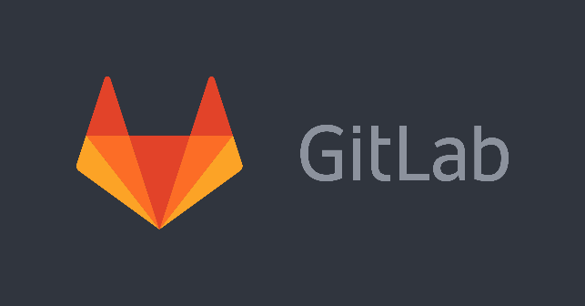
System Configuration
Maven
Tomcat
PostgreSQL
Selenium
Linux
Linux
Linux
JENKINS CONTAINER
BUILD CONTAINER
DEPLOY & TEST CONTAINER
DOCKER ENGINE
Source Code Management
KERNEL
Docker hub
HOST OS
Notes:
30
I have divided the process in stages : Fetch, Build, Deploy and test
I have constructed 3 containers in my system for each of the stages :
Jenkins container which automates the entire process and trigger other containers.
Build Container : which builds the java code using maven and runs unit test using Junit.
Deploy & test Container : The App is built successfully is deployed inside this container on the tomcat server and then selenium is used to run integration tests on it.
Docker Engine is the key to the entire system. It facilitates the communication.
Gitlab is the SCM where the source code is pushed.

Slide 14



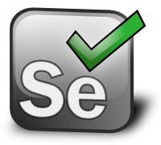
Work Flow
Push changes to repository
Jenkins Polling
Triggers build container
Build & Unit Test
Build container
Artifacts are archived
Artifacts deployed for testing
Jenkins container
Deploy & Test
DOCKER ENGINE
Notes:
40 This is the kind of system that I have built
The Jenkins container is connected with the Gitlab repo and it keeps polling the repo for changes.
As soon as developers push their code to the repo, because Jenkins is polling it, it detects the change in repo
And triggers a new container : The Build Container.
This Build Container uses maven to build the project and runs unit tests on it.
If there is a failure, reports are sent to the developers.
On a successful build, the outcome of the build ie the artifacts, WAR file in my case are preserved in the Jenkins container.
The Jenkins container then triggers the deploy container. The artifacts are deployed in this container, and integration testing using selenium is performed.
Reports are sent to the developers.

Slide 15
Demonstration
Notes:
60 Step 1 Try to access to Jenkins through browser(http://10.68.253.47:30073)
Step 2 Launch Jenkins Container through command window
Step 3 Access to Jenkins through browser again
Step 4 Commit change of code through Intellij
……
Step N Access to tomcat through browser(http://10.68.253.47:40073)

Slide 16
Comparison
Task | Traditional Way | Time | Docker Way | Time
Preparing Environment | jdk Maven PostgreSQL Tomcat | 1-2 hours | Install Docker Engine | 30min
Launching the CI Server | Install Jenkins on the machine manually and configure it. Configure the build server. Setup a Jenkins agent for communication. | 3-5 hours | Pull/Load Customized Docker Images(Jenkins, Maven) Launch Docker Containers | 1min
Notes:
Okay ! SO now that you know my system. Why is it better ? How did it solve the problem ? Problem was portablility. Intriducing CI/CD was a tedious task right ?
This is a comparison based on time and efforts on introducing CI/CD in my case in terasoluna. There are 2 steps :
Preparing the environemt Using the traditional way, I had to install JDK…… keeping in mind the version compatibility. It took me 2hours
Next step was to Launch the CI server which is Jenkins : Install Jenkins ……..
Inall it took me a day to setup CI Server using the old way
On the other hand, when I used Docker Way,
TO prepare the enviroemnt I just hgadto install Doicker Enginre.
Since all these tools and dependencies are avaiolable packaged is a docker image with BEST COMPATIBLE VERSIONS, I just had to pull them and run them using docker engine.
IT eliminated the tedious manual work of setting up the enviroenmt, because the entire enviroenmnt is present as an image.
And hence it made the expansion of DevOps easy too. Host this image on a private cloud of NTT Data and for every project that you want to introduce CI/CD, pull the image and your CI server is ready.

Slide 17
CONCLUSION
Optimized the following :
Time
Quality
Cost
Notes:
60
More releases -> more rigorous testing -> better quality
TO conclude this ppt, I would say
Its clear that the containerized way of introducing CI/CD significantly benefits us in term of Time, shorter development cycles, more releases, rigourpous tresting , better wuality
Hence Time to market, Quality and Cost are all optimized.

Slide 18
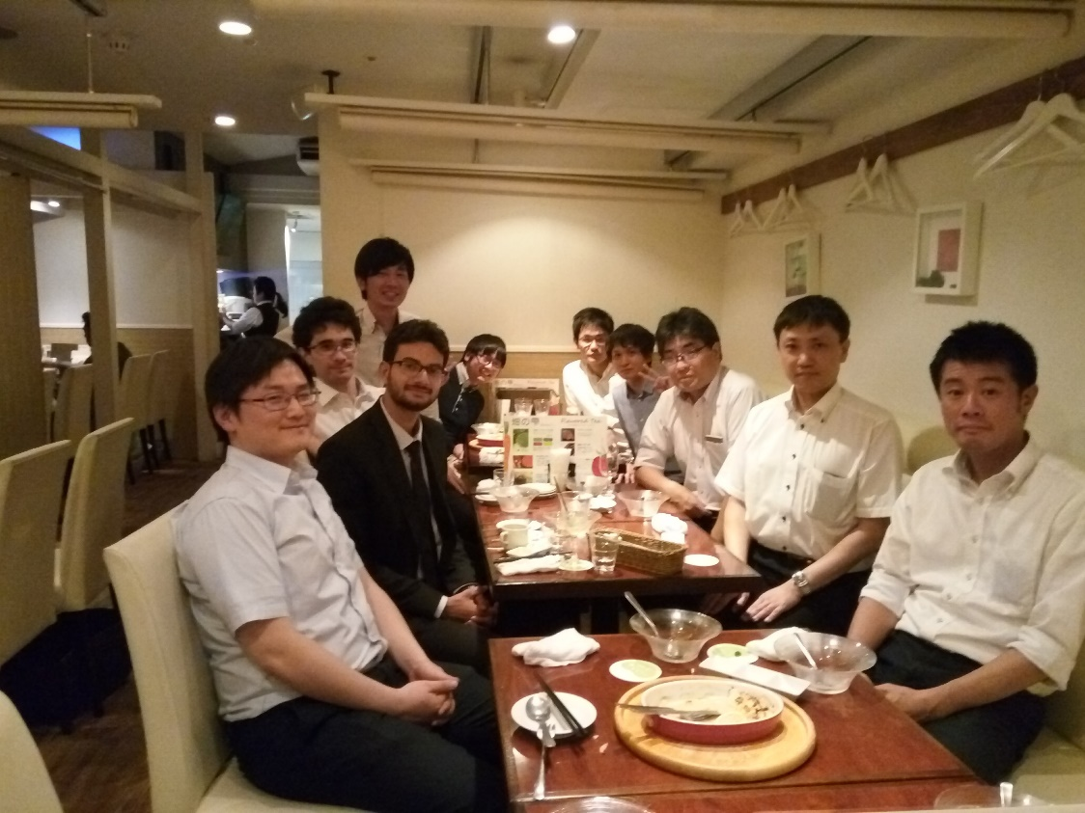
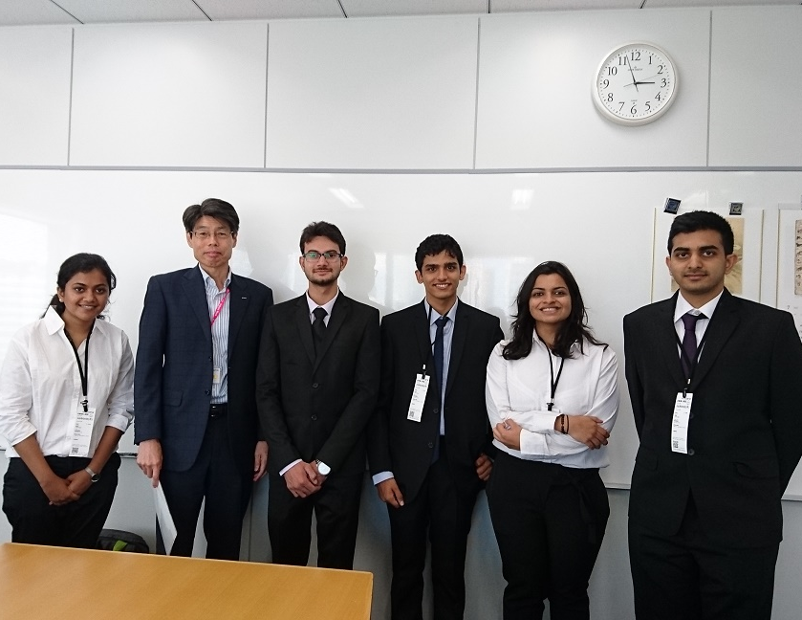

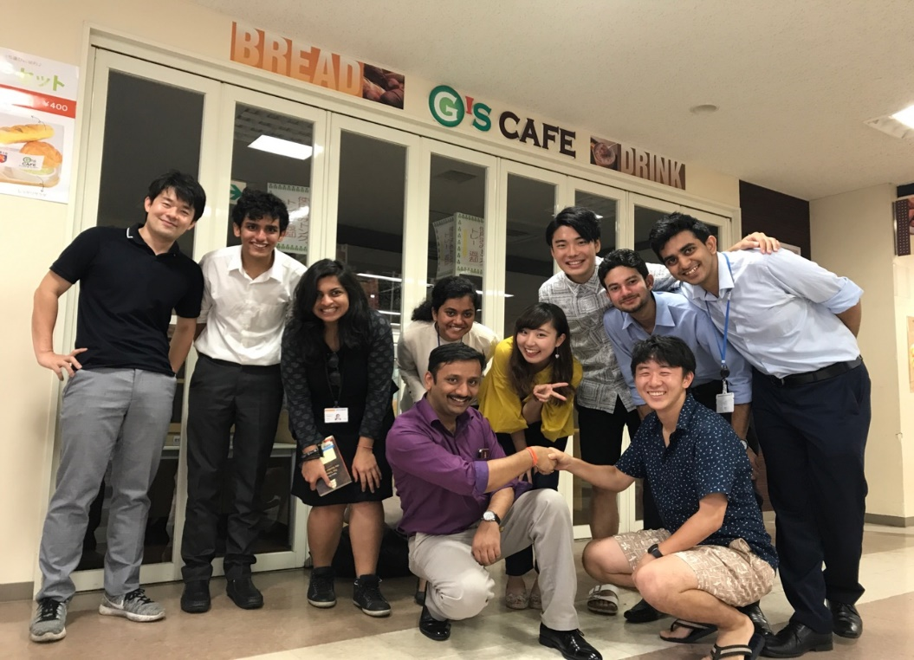
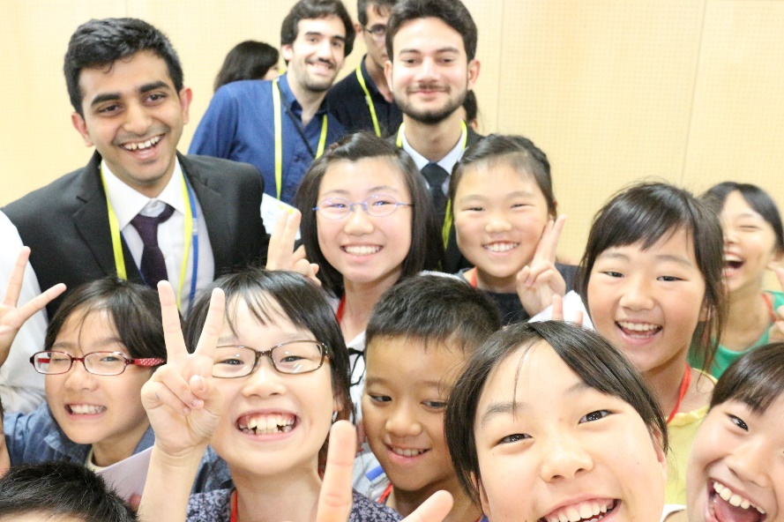
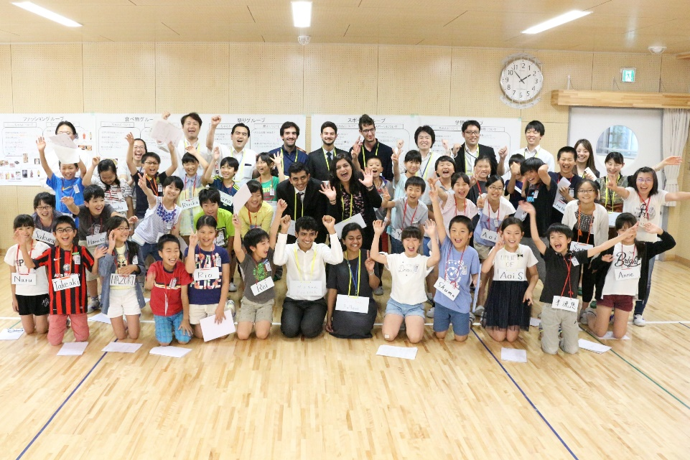
Experience at NTT Data, Japan
Notes:
Vote of thanks, pictures of japan and all events and thanking everyone for everything I would like to thank my trainer Philip-san for helping me build this system and my manager Nagashima-san for keeping me motivated to complete this.
This is a glimpse of my internship in Japan.
Thanks to the HR Team for organizing such amazing events and giving us some unforgettable memories.
Thank you !

Slide 19
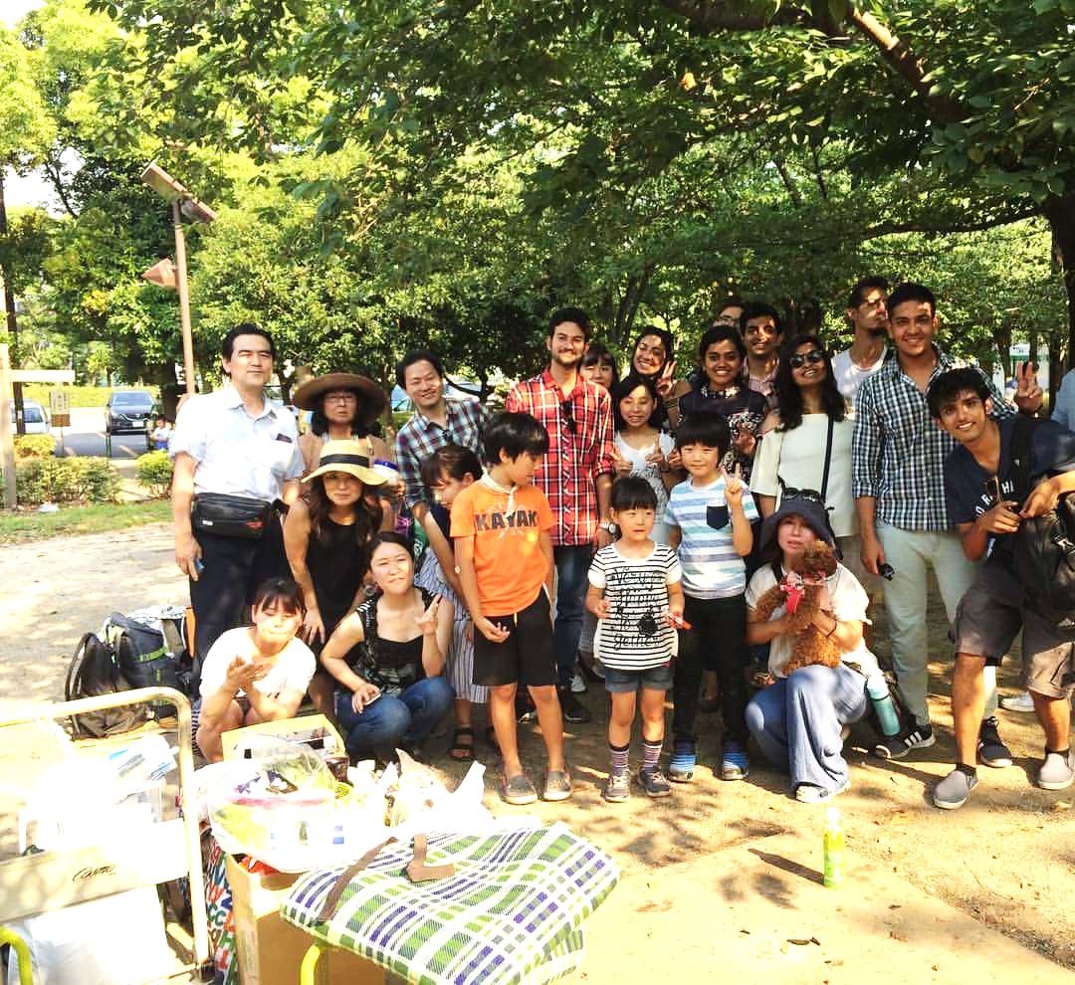
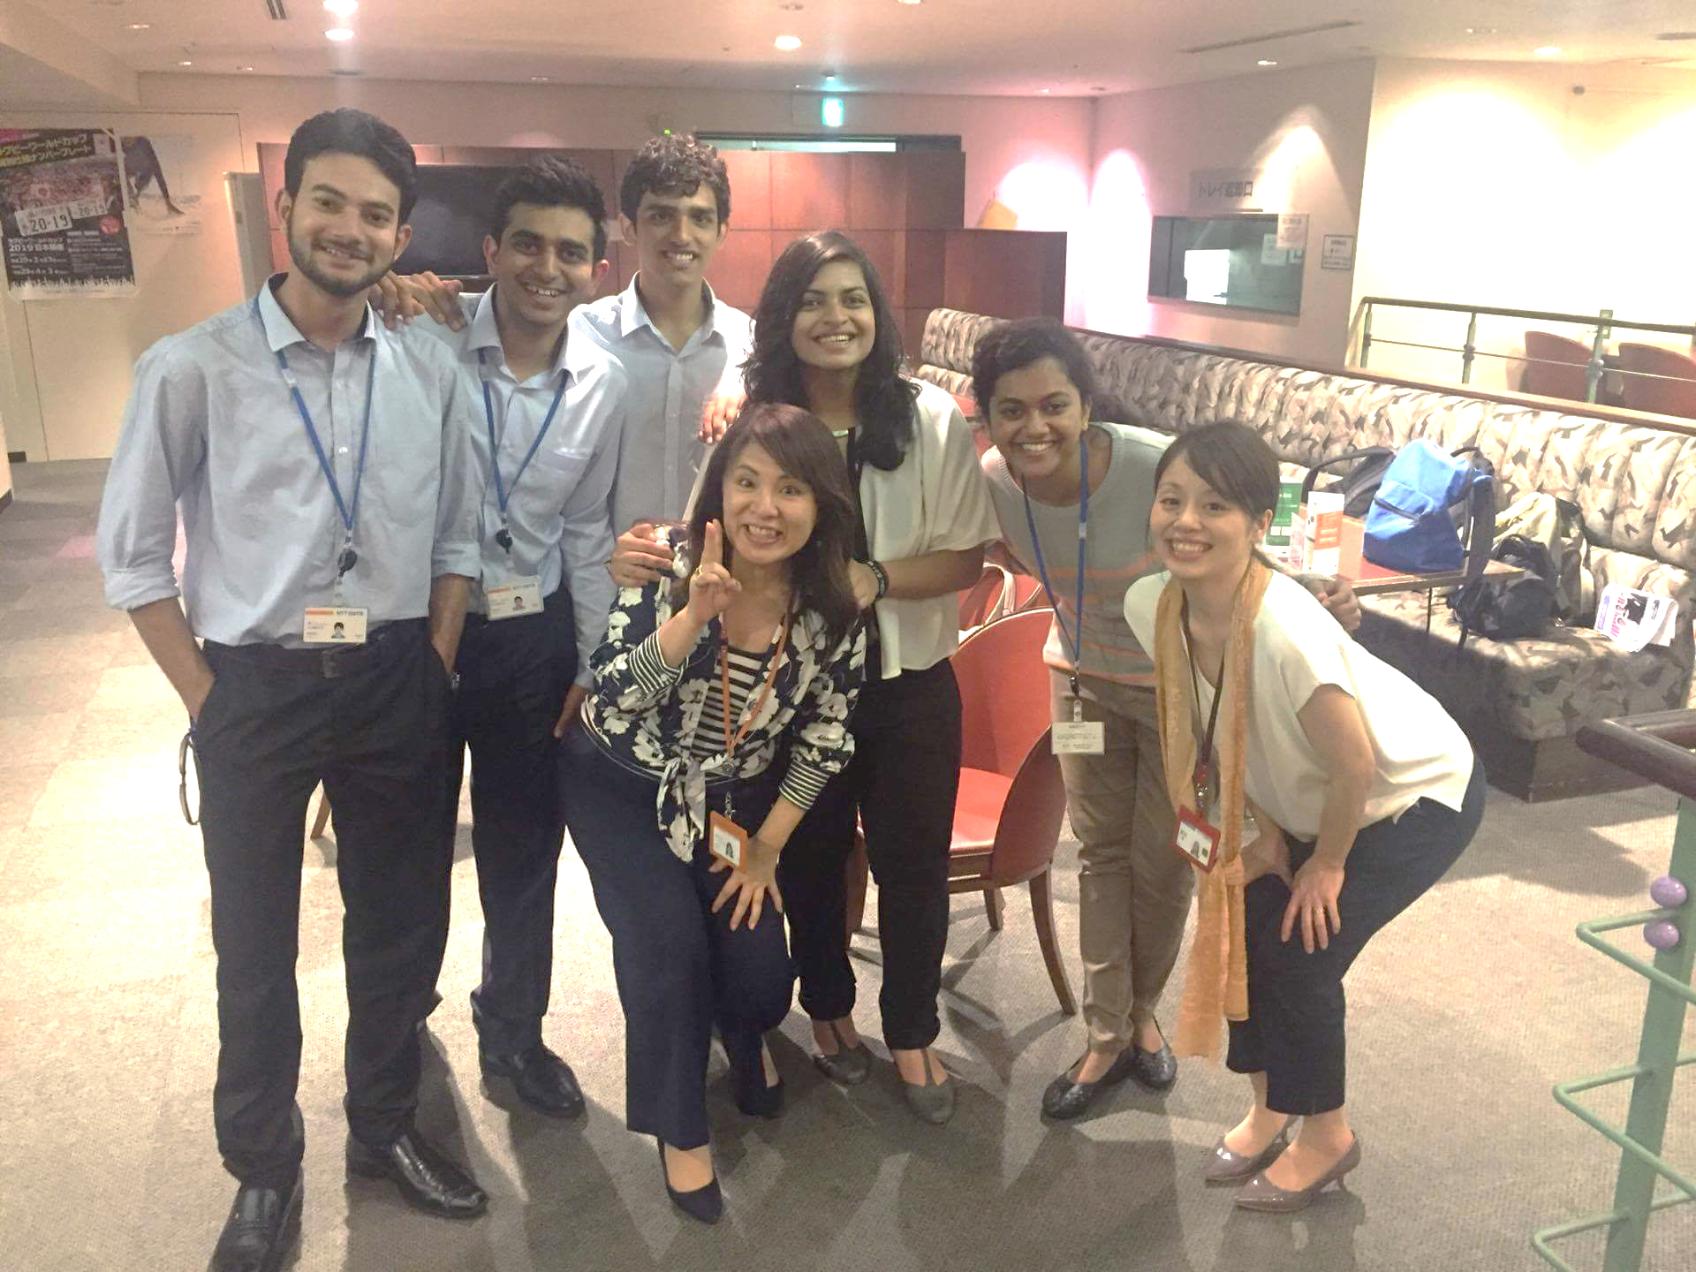

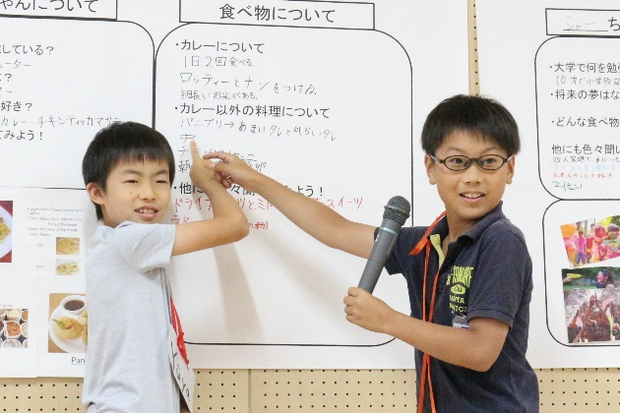
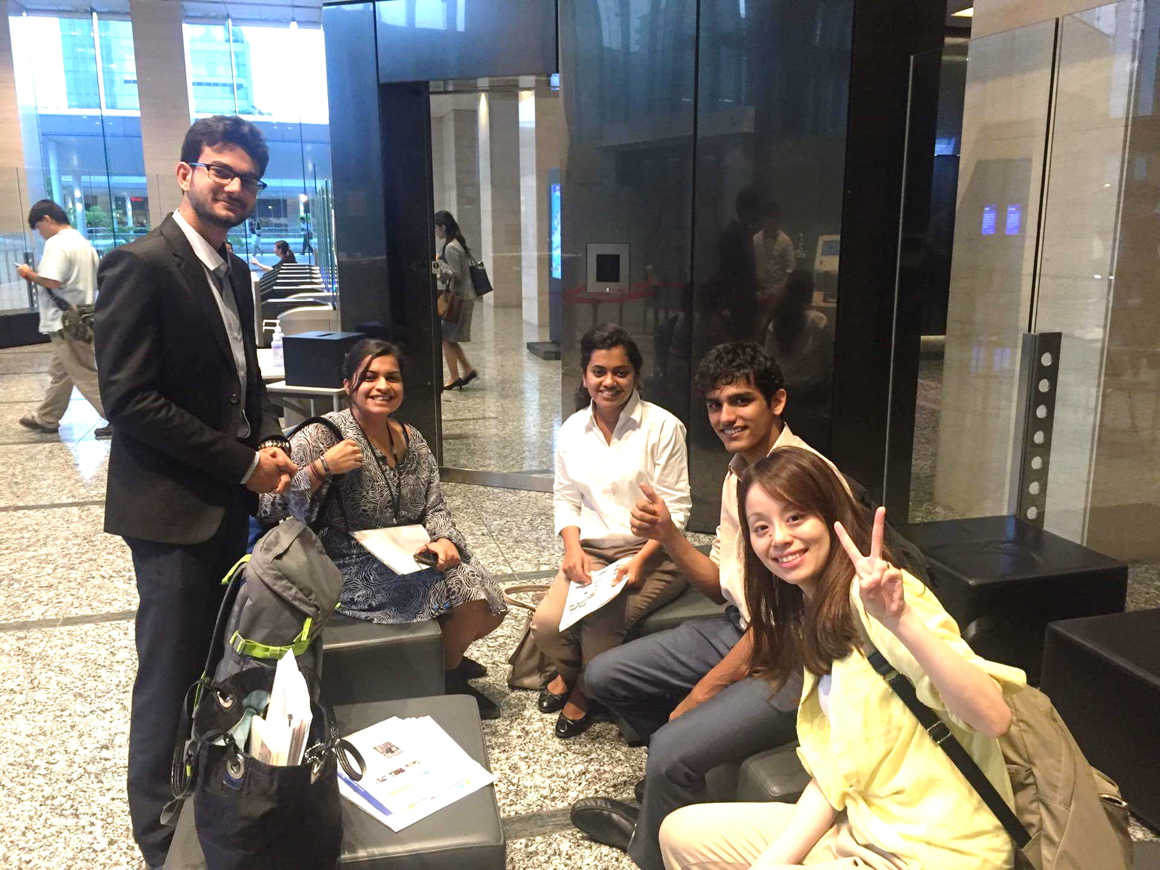

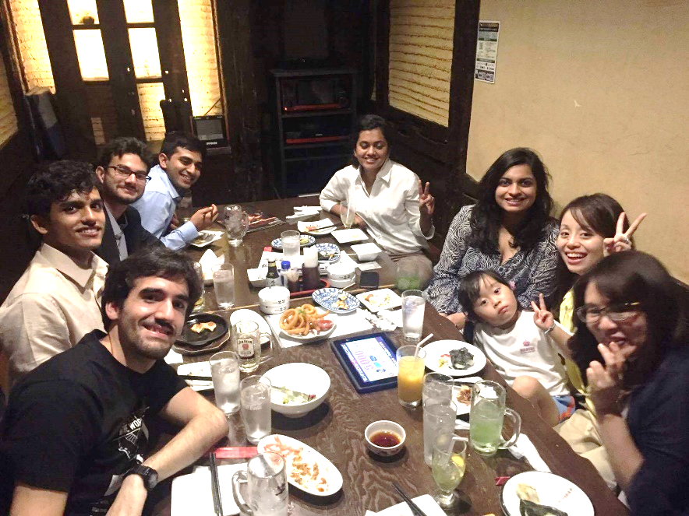

Slide 20
QUESTIONS ?

Slide 21
REFERENCES

Slide 22
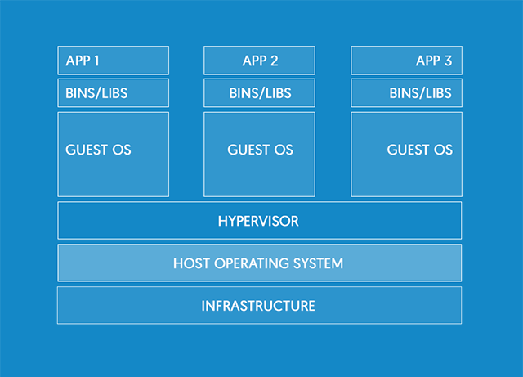
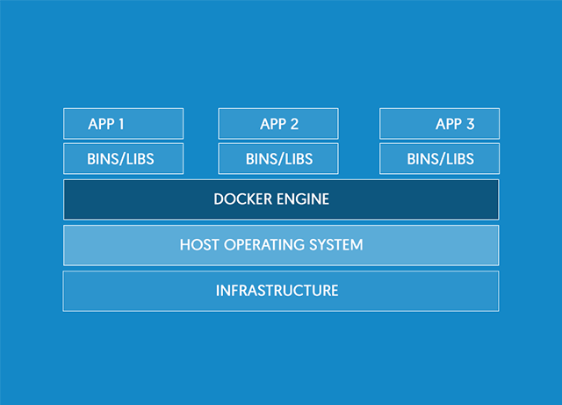
Docker Containers
VM
Container
Different Apps on Different Guest OS
Different Apps on Different Containers but all containers on the same OS
Notes:
20
In the VM environment, there are multiple guest OSs on 1 host OS. But in containers … Docker and container environment, difference from VM and how its better

Slide 23
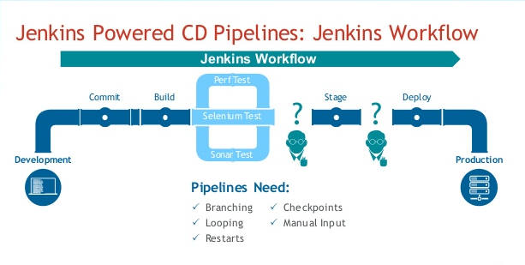
Notes:
20

